Slide 1
CSS layout fundamentals & common usage
Aniruddha Daripa
October 20, 2023

Slide 2
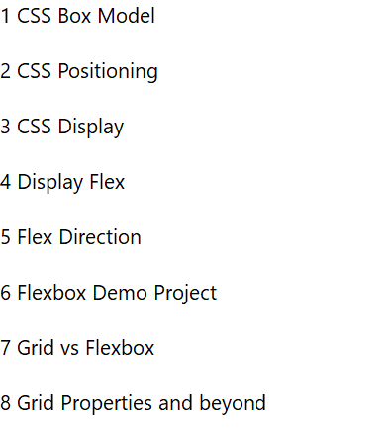
Agenda

Slide 3
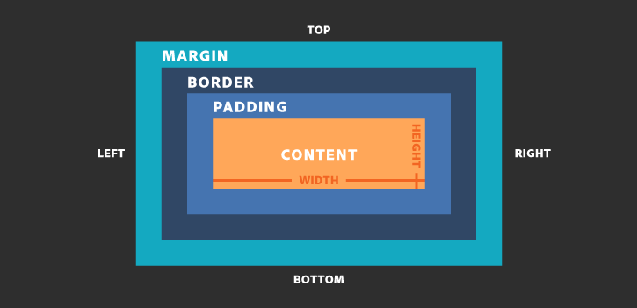
CSS Box Model
“Box Model" is used when talking about design and layout.
it is consists of: margins, borders, padding, and the actual content.
For Example :
Box-sizing property : defines how the width and height gets applied on an element.
content-box: The width & height of the element only include the content. In other words, the border, padding and margin aren’t part of the width or height. This is the default value.
border-box: The padding and border are included in the width and height.
<head> <style>
span {
width: 300px;
background: yellow;
padding: 15px;
border: 10px solid gray;
margin: 10px;
display: inline-block;
/*box-sizing: border-box;*/ }
</style> </head>
<body>
<h2>Calculate the total width:</h2>
<span>I am Box Model - Span Element</span>
</body>

Slide 4
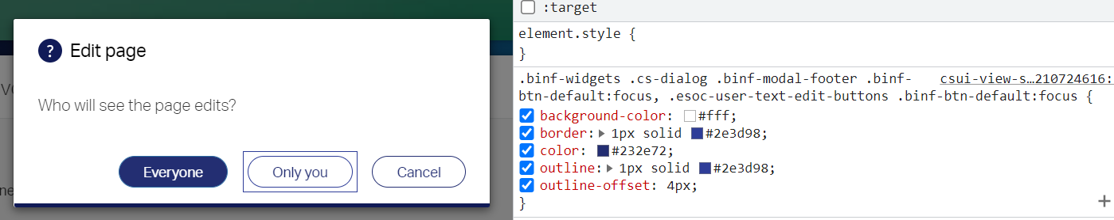
CSS Border & Outline
CSS border properties allow you to specify the style, width, and color of an element's border.
The border property is a shorthand property for the following individual border properties:
border-width
border-style (required)
border-color
Outline is a line drawn outside the element's border.
CSS has the following outline properties:
outline-style
outline-color
outline-width
outline-offset
outline

Slide 5
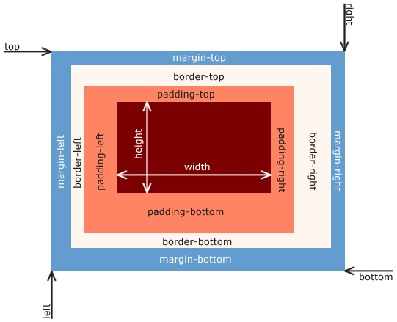
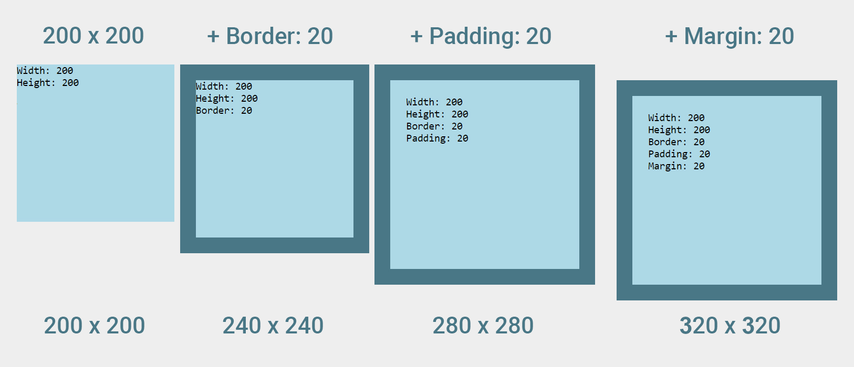
Height and width calculation within Box Model

Slide 6
CSS Positions
What is CSS?
The position property specifies the type of positioning method used for an element.
Elements positioned using the top, bottom, left, and right properties depending on the position property.
There are five different position values:
Static : default value, dose not get effected by top, bottom, left, and right properties , positioned according to page flow.
Relative: relative to its normal position. honors top, bottom, left, and right properties, Other content will not be adjusted.
Fixed: is positioned relative to the viewport, The top, right, bottom, and left properties can be used.
Absolute: relative positioning to the nearest positioned ancestor, top, right, bottom, and left properties helps to position is according to its ancestor or document body.
Sticky: positioned based on the user's scroll position. sticky element toggles between relative and fixed.
Let’s try to play with CSS positions to have a better understanding.

Slide 7
Horizontal & Vertical Align
Center Align Elements : using margin auto and width of the element
Center Align Text: using text-align: center;
Center Align image: using left and right margin;
Center Vertically: Using line-height
Center Vertically: Using margin or padding
Left-right alignment: using float

Slide 8
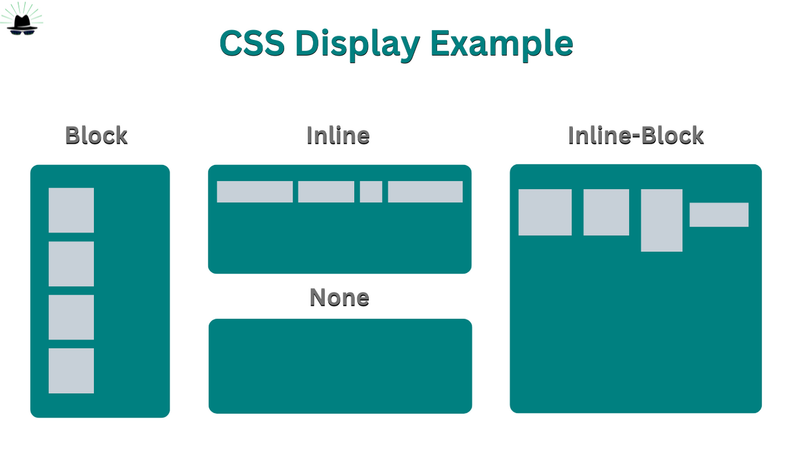
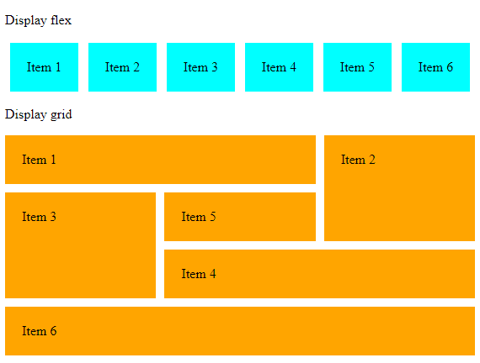
CSS Display properties
Display properties playtime: https://codepen.io/veerendratikhe/pen/RVLemx

Slide 9
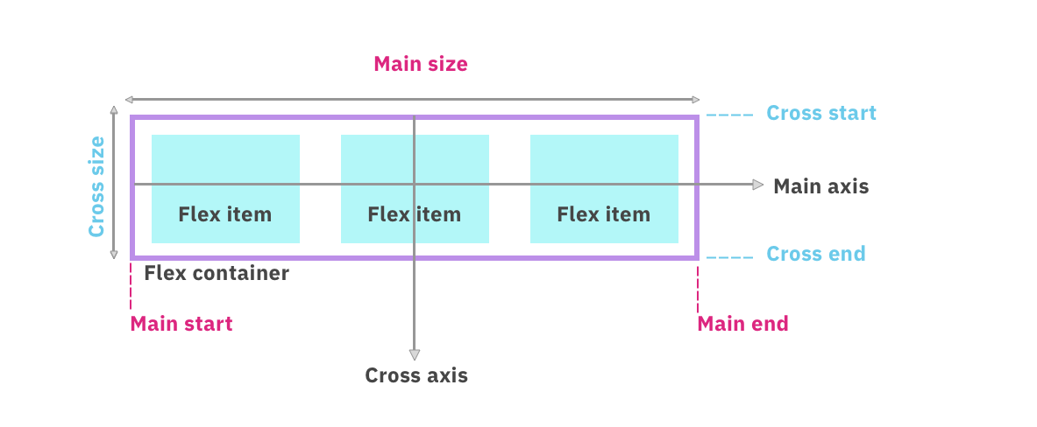
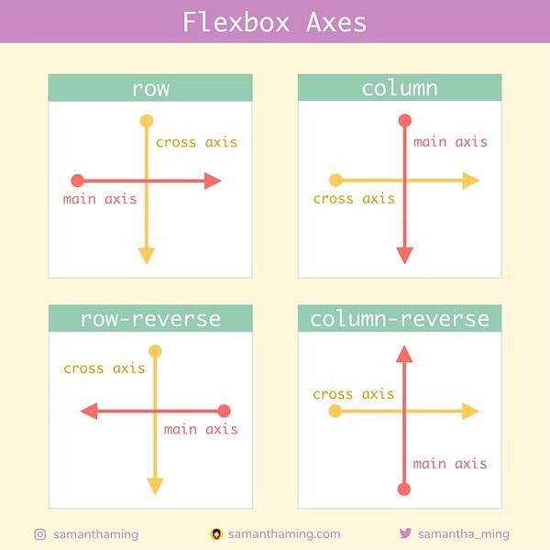
How flex sizing works, concept of flex Axes
Flex box sizing checklist: actual content width < Width < flex-basis < min-width/max-width
Blog Time: A Complete Guide to Flexbox
( https://css-tricks.com/snippets/css/a-guide-to-flexbox/ )

Slide 10
Flex vs inline-flex
display: flex
Creates a block-level container.
Expands to fill the available horizontal space.
Stacks elements vertically by default.
Suitable for main page layouts, div containers, or major sections.
Elements stack vertically within the container.
display: inline-flex
Creates an inline-level container.
Occupies only the width necessary for its content.
Elements remain in a line, with no line breaks.
Ideal for inline elements within a paragraph, such as buttons or icons.
Elements remain in a horizontal line without line breaks.
"In summary, display: flex is used for block-level containers, and it stacks elements vertically. On the other hand, display: inline-flex is perfect for inline-level containers, maintaining a horizontal line of elements."

Slide 11
Flex vs Grid
CSS Grid
Two-dimensional.
Perfect for complex grid-based or table layout with rows and columns.
Provides precise control for both horizontal and vertical alignment.
Supports complex responsive layouts, adapting grid based on viewport width.
Allows for nesting grids for advanced structures.
Growing browser support, may need prefixes in older browsers.
CSS Flexbox
One-dimensional.
Best for single-row or single-column layouts.
Ideal for aligning items within a container.
Great for responsive design within a single row or column.
Suitable for nesting flex containers for intricate layouts.
Good browser support, even in older browsers.
Conclusion:
"In summary, Flexbox is great for simpler, one-dimensional layouts, while Grid excels in creating complex, two-dimensional grid structures. In practice, they can be used together to achieve versatile and responsive web designs."
Blog Time: https://css-tricks.com/quick-whats-the-difference-between-flexbox-and-grid/

Slide 12
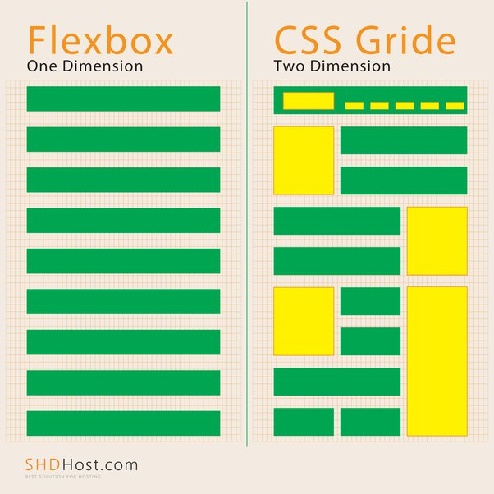
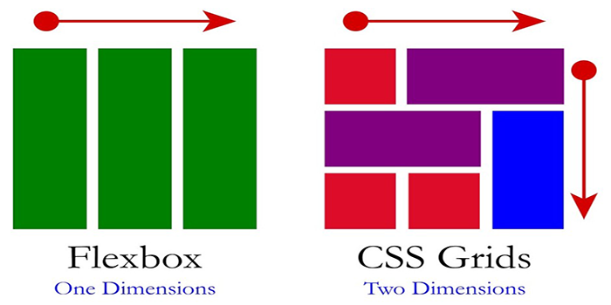
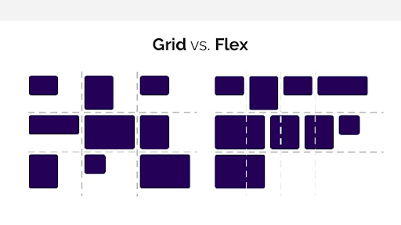
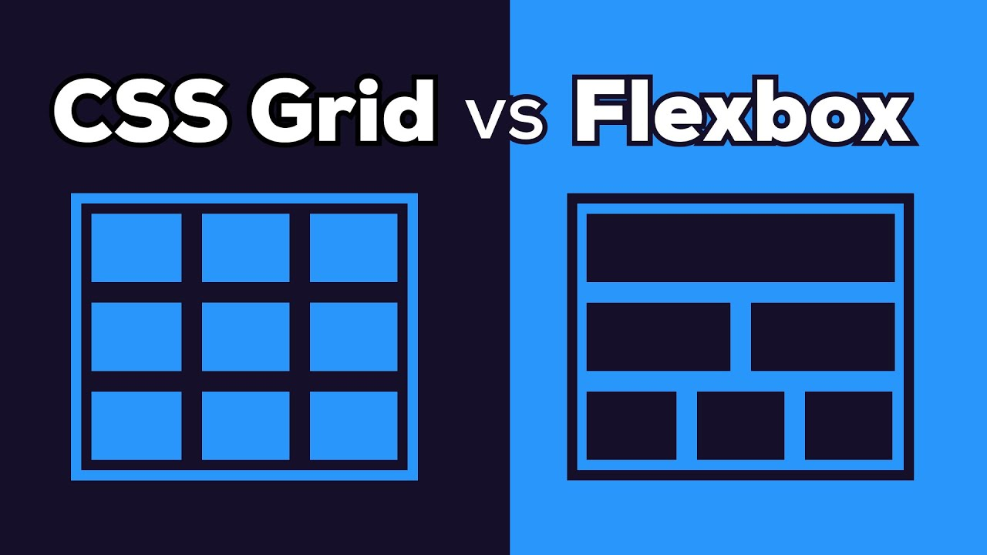
Flex vs Grid

Slide 13
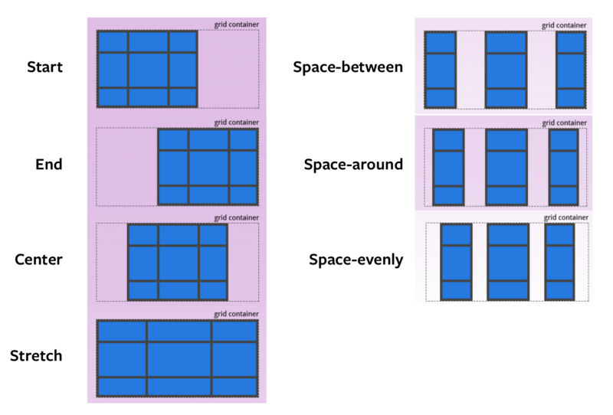
Grid Properties
Blog Time : https://www.freecodecamp.org/news/how-i-remember-css-grid-properties-3afee895763/

Slide 14
Thank You

